Slide 1

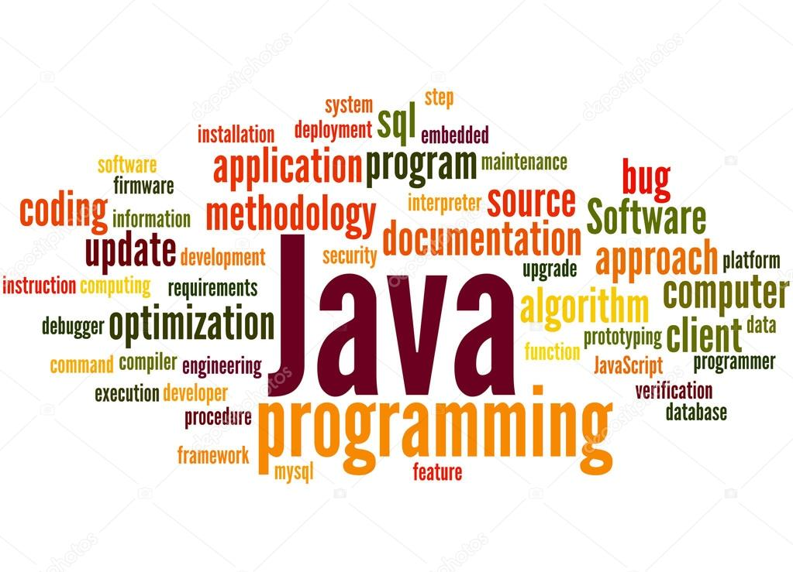
Java Standard Libraries
Ahmaad Jackson

Slide 2
Elevator Pitch
https://youtu.be/whEKyyAuRdY

Slide 3
About
Java Standard Library consists of various packages
Packages are groups of related classes
Packages help to organize code
Packages provide a extra layer of encapsulation
Notes:
Encapsulation- Binds code & the data it manipulates together
Keeps Code & Data Safe from external interference & misuse

Slide 4
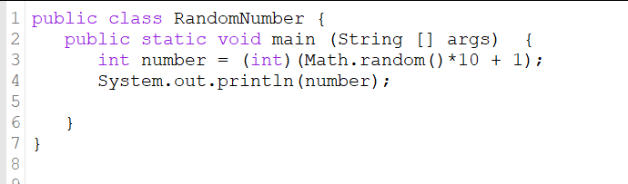
Java Libraries
java.awt- used for graphical applications
  Supports the Abstract Window Toolkit(AWT)
java.awt.color- used for drawing operations
  Color.red = new Color(255, 0, 0);
  Color.WHITE = new Color(255, 255, 255);
java.io- used for input & output functions
java.lang- java fundamentals
java.util- contains a wide variety of utility classes
java.math- used to perform calculations
  Math.random()
Notes:
AWT- Java’s original graphical user interface framework, replaced by JavaFX
Color- colors defined in Color class for convenience
Java.lang- Automatically imported into all java programs

Slide 5
Java Libraries Continued
java.net- used for networking applications
java.security- for security framework
java.sql- used for data storage & processing
  Structured Query Language(SQL)- programming language used for data management operations
  Java Database Connectivity(JDBC)- used to access any data source
    JDBC API is SQL-Based
    java.sql is one of the 2 packages in the JDBC API

Slide 6
Java.net
java.net.InetAddress- represents an Internet Protocol Address(IP Address)
  InetAddress address = InetAddress.
    getByAddress(String hostName)- creates an InetAddress given the host name & IP Address
    getByName(String hostName)- Takes the host’s name & determines the host’s IP address
    getAllByName(String hostName) - Same as getbyName, except it takes the whole host’s name
    getLocalHost()- returns the address of the local host

Slide 7
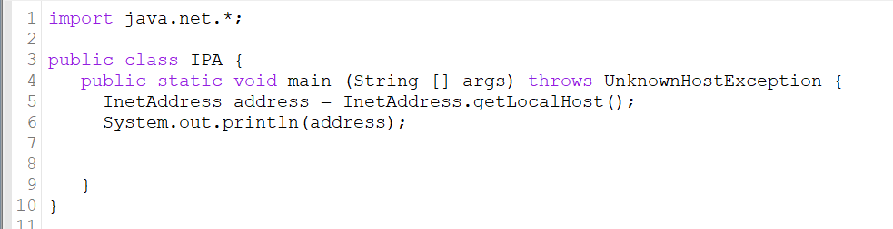
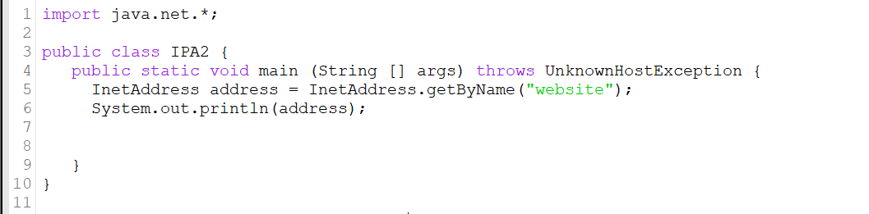
getLocalHost & getByName

Slide 8
Sources
Java Platform SE 8
  https://docs.oracle.com/javase/8/docs/api/index.html
InetAddress Example Program in Java
  http://www.java-samples.com/showtutorial.php?tutorialid=399
Schildt, Herbert. Java A Beginner’s Guide Seventh Edition. McGraw-Hill Education, 2018. Print.

